Slide 1
Chatbot Application Question

Slide 2
1. What is the System Design (architecture diagram) for the chatbot application?
Level 0 System Design
Chat Bot Application
Ask Query
Update
User
Admin
Get Result

Slide 3
Level 1 System Design
Login
SID
User
Process Query
Get the data as json
Deep Learning Model
Of the intent as found
Give the response
Else give query is not understood

Slide 4
2. What kind of algorithm you will use?
There are several algorithm currently used in the market for the chatbot application. The most popular in current year are NLP based chatbot application.
Natural language processing (NLP) :
Chatbot can answer users queries in natural language which is made possible by using an artificial intelligence term natural language processing or NLP. Natural language processing gives machine the ability to ingest the given input, break it down, extract it's meaning , determining appropriate action and answering user in there natural language. Natural language processing (NLP) has two subsets Natural language understanding (NLU) and natural language generation (NLG). NLU takes unstructured data as input and convert it into structured data so machine can understand and act upon it. NLU focuses on extracting the meaning from user input query. Natural language generation (NLG) simply converts the answer generated by chatbot in structured data to human understandable natural language. Natural language processing (NLP) does processing in 5 steps. The unstructured data is first passed for lexical analysis. The structure of words is analyzed and identified. The whole input text is divided into tokens. Then the tokens are passed to syntax analysis where tokens are analyzed for grammar and arranged in a way in which relationship among the word is easy to understood. Then the input is passed to semantic analysis. The meaning of words or tokens is extracted in this step.

Slide 5
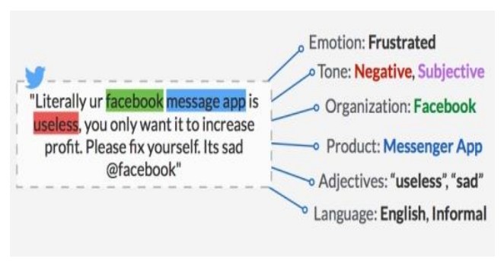
Next step is discourse integration where the meaning of sentence is tried to extracted using the previous sentence meaning. Final step is pragmatic analysis. In this analysis, the main emphasis is on what was said is reinterpreted on what does it actually meant. After all this steps the meaning of sentence is known to machine and it finds answer to user query and passes it to Natural language generation (NLG) for generation of final output. Natural language processing (NLP) is used in many chatbot for effective communication with humans.

Slide 6
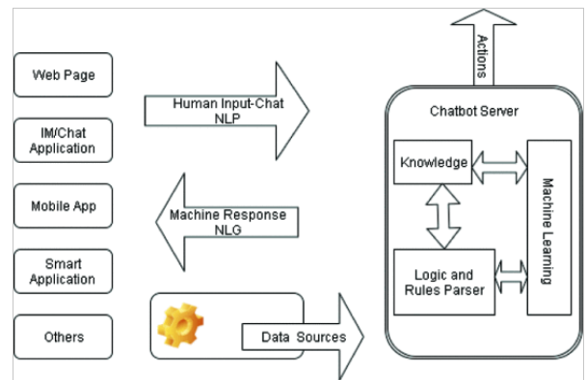
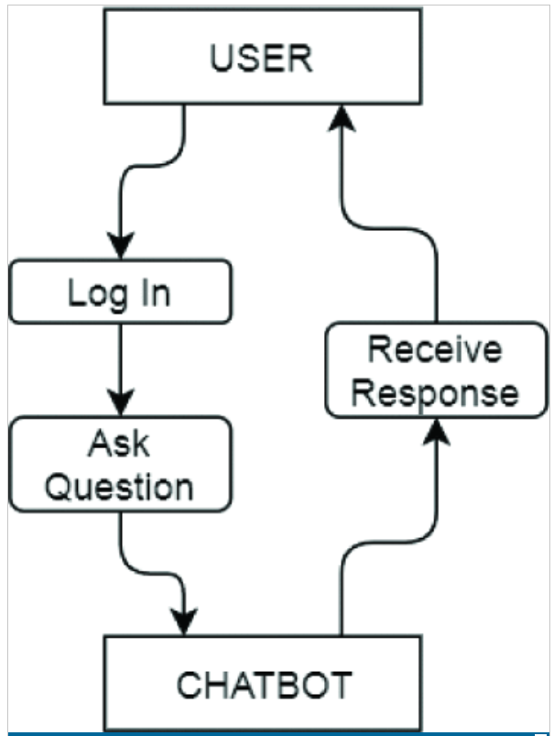
3. How does the bot understand what the customer is saying?
Natural language processing (NLP) does processing in 5 steps. The unstructured data is first passed for lexical analysis. The structure of words is analyzed and identified. The whole input text is divided into tokens. Then the tokens are passed to syntax analysis where tokens are analyzed for grammar and arranged in a way in which relationship among the word is easy to understood. Then the input is passed to semantic analysis. The meaning of words or tokens is extracted in this step.
Next step is discourse integration where the meaning of sentence is tried to extracted using the previous sentence meaning. Final step is pragmatic analysis. In this analysis, the main emphasis is on what was said is reinterpreted on what does it actually meant. After all this steps the meaning of sentence is known to machine and it finds answer to user query and passes it to Natural language generation (NLG) for generation of final output. Natural language processing (NLP) is used in many chatbot for effective communication with humans.

Slide 7
4. What if you encounter with a new question that bot didn’t see while training?
Start
GUI for User
As there are different option we can have in this scenario
1. Show different option related to query
we can show different option related to search made by the customer to choose like if user has search what is the amount of booking the table at restaurant? But bot doesn’t understand it since it understand the price word so it will show the option to the user are your searching for the price for booking the restaurant?
We can show these option to the user to select the option from our word of training which bit has trained.
2. Show default message our team will contact you
If the asked question is not answered by our bot to the customer than we can show the answer the question which you have asked is not found our team will be in touch with you. And in the next training we will include all these type of query to train our bot.
Chatbot send welcome message
User Shall search for the needs in Natural Language
Get user defined natural language query then identify intent and entities in that query
Fetch database to search for the user query related to data
Able to find
Ask user to search for required data in more efficient way
No
Yes
Show data to user
Yes
Ask user for more help
No
Stop
Show good bye message

Slide 8
5. How does the bot continue to learn once it’s live? Or how can I make sure that my bot won’t turn crazy and start speaking nonsense?
Once the bot is live we can keep the new question in one section store in our database in which the result has not been shown or new question and we can again train the bot will all the new question every night or once in a week as per our requirement
We can handle all the nonsense and other word intent and entities by the NLP. All the negative words which will be judge by our bot will be removed and does not show to the customer.

Slide 9
6. How would you optimize when thousands of users will be interacting with the bot?
We can optimize our bot for showing result to convert the our trained model to the restfull API and provide the sufficient server to run the model and handle the user flow.
We can use the AWS cloud to publish our API in the AWS gateway or use the EC2 instance also. We can also use the load balancer to avoid over loadness on the server from the user hit.

Slide 10
Thank You

